Slide 1


Kanak print-n-pack
C

Slide 2
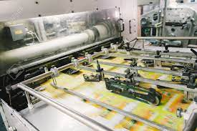
C
About us
Established in the year 1997, we “Kanak Print-N-Pack ” is one of the Leading Manufacturer and Dealer of a wide range of Paper, PVC & PP Products used in the packaging and value addition for your products
We are engaged in manufacturing, supplying, wholesaler, distributer, trading a wide assortment.
Printed Satin
Ribbon Roll
Rubber Silicon Label and Taffeta Labels
Printed Stickers, Paper Sticker.
Packaging like Clear PVC Bag, Soft PVC Pouches
Stitched Pvc bags
Thermocol sheets
Packaging Boxes
Rubber tags & Rubber keychain
Our valued clients can avail these products from us at reasonable rates. Ably led by “Mr. Mahendra Mehta” to outshine all competitors in all aspects.We have gained a remarkable and strong position in the market.

Slide 3
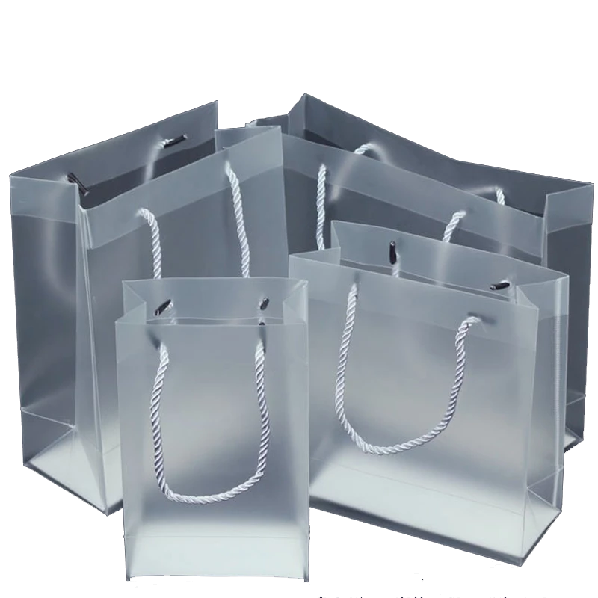
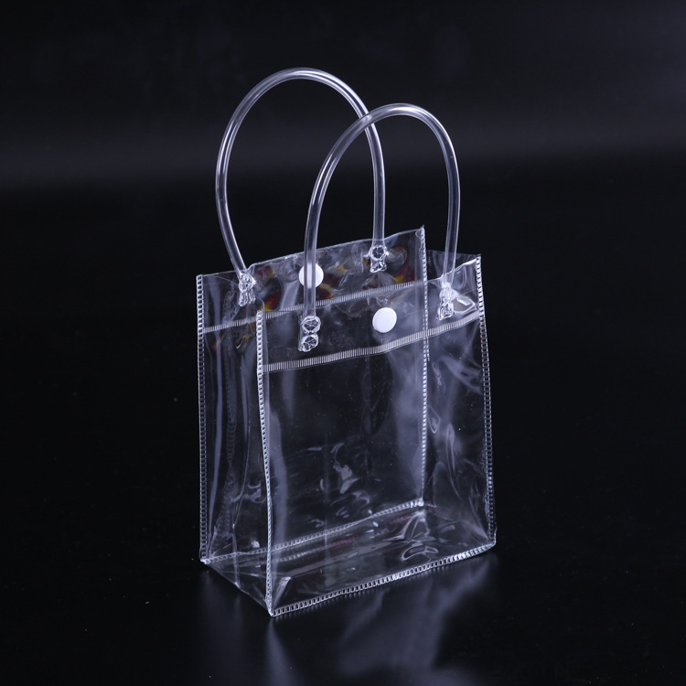
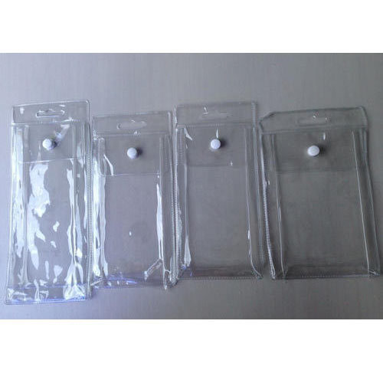
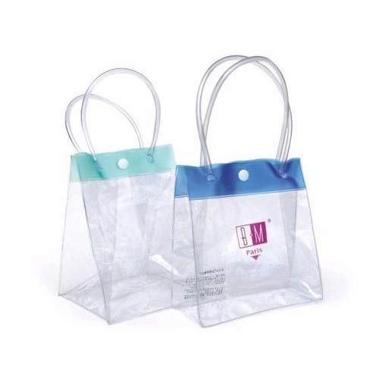
C
PVC BAG
Usage/Application | Packaging
Size | ANY
Material | PVC SOFT
Shape | RECTANGLE & SQUARE
Is It Transparent | Transparent
Features | SOFT AND FLEXIBLE also contains button, Velcro etc.
Hardness | SOFT

Slide 4
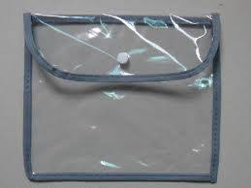
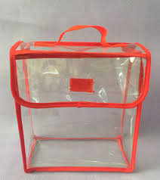
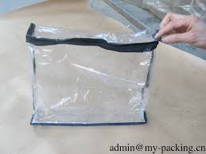
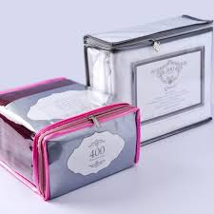
C
PVC STICHING BAG
Usage/Application | Features
Size, Color | Customized
Design Type | Customized
Usage | Product Packaging, Promotion
Handle Type | Customized
Pattern | Plain, Printed
Printing | Screen
Closure Type | Open, Button, Zipper, Peel & Seal, Resealable, Heat Seal

Slide 5



C
Contact Us
Office : 9/11,Ladwadi,Shakti Sadan,3rd Floor, R N 20,Old Hanuman Lane,Kalbadevi Road, Nr Old Hanuman Lane, Mumbai-400002.
Mahendra Mehta 9322299267
Vastupal Mehta
9029031502
Works: Unit No 106, 1st Floor, building no A6, Prerna Complex,Dapoda Road, Val Village, Bhiwandi 421302, Thane.
kanakprints1@gmail.com

